Slide 1

DRAG REDUCTION SYSTEM PROJECT
Master degree in Mechatronics Engineering Mechatronic Systems Simulation
Albi Matteo Consalvi Natale Pettene Mattia
Academic Year 2021 - 2022

Slide 2
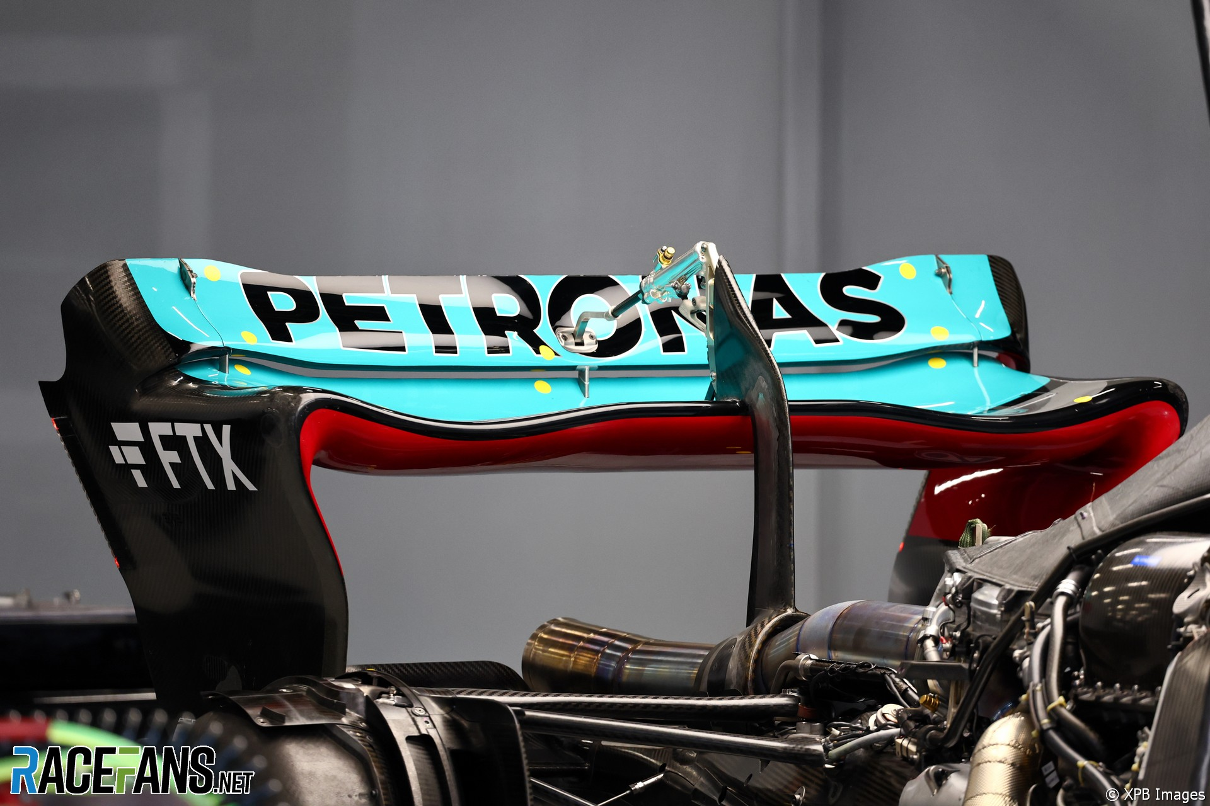
SYSTEM DESIGN REQUIREMENTS
High aerodynamic efficiency
High precision
Quick motion
Low power consumption
Compliance with rules
Easy to assemble
Durability
Structurally safe
Lightweight

Slide 3
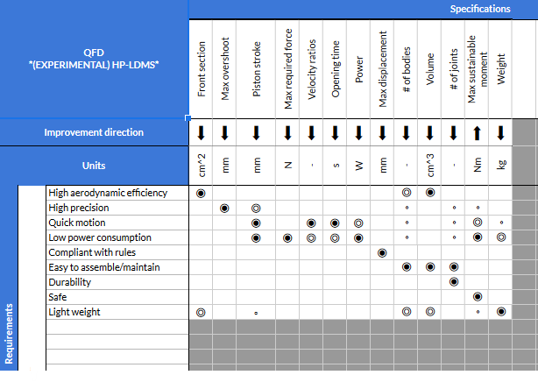
SYSTEM DESIGN MATCHING REQUIRIMENTS AND SPECIFICATION

Slide 4
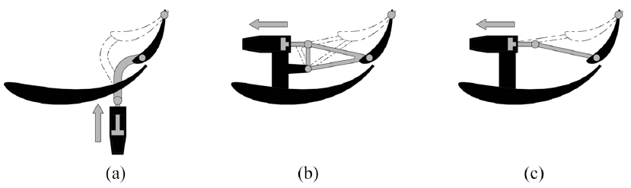
SYSTEM DESIGN EXISTING SOLUTION COMPARISON
PUSH-UP
Simple and economic
Easy access to hydraulics
Great actuator’s effort
Disturbances
POD-ROCKER
Low actuator’s effort
Eliminate disturbances
Higher costs
Complexity
POD-PULL
Simple and economic
Eliminate disturbances
High pressure required

Slide 5
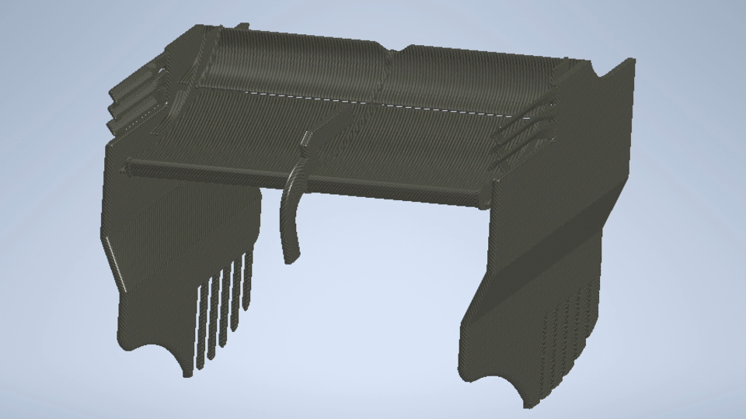

Slide 6
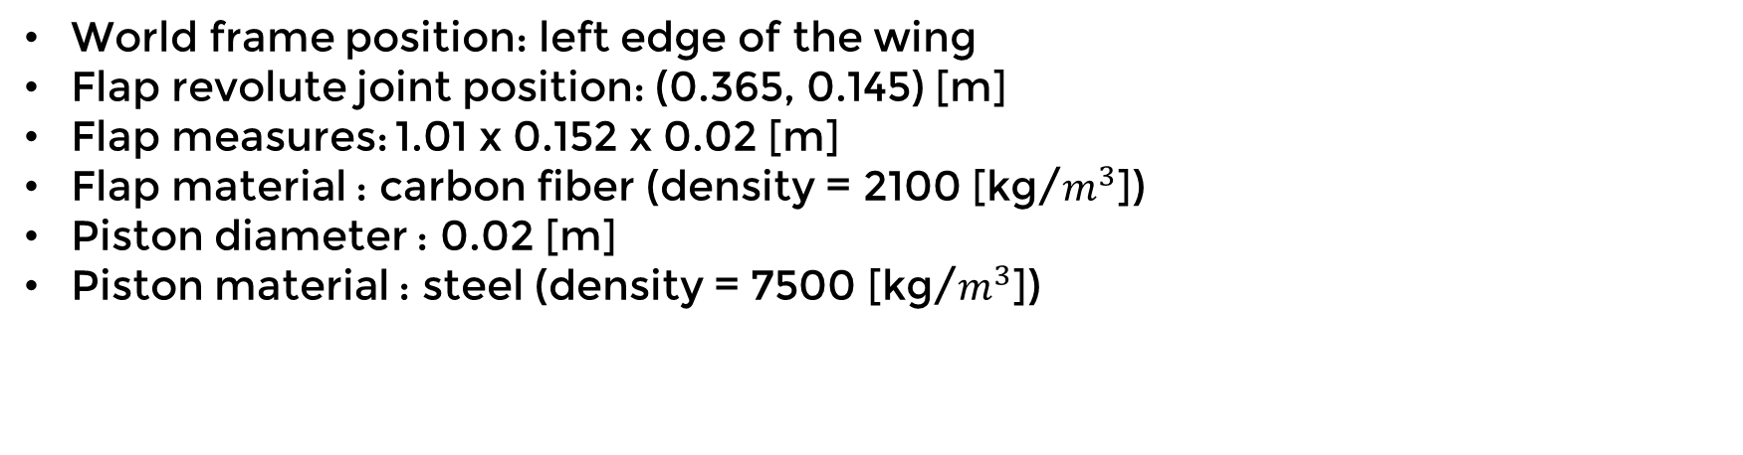
ASSUMPTION DATA FROM PAPERS AND CADs
World frame position: left edge of the wing
Flap revolute joint position: (0.365, 0.145) [m]
Flap measures: 1.01 x 0.152 x 0.02 [m]
Flap material : carbon fiber (density = 2100 [kg/$m^{3}$])
Piston diameter : 0.02 [m]
Piston material : steel (density = 7500 [kg/$m^{3}$])

Slide 7
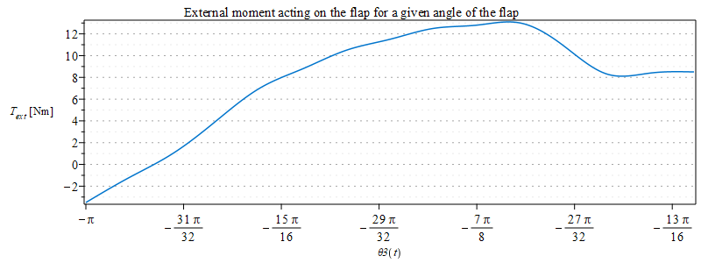
ASSUMPTION EXTERNAL AERODYNAMIC TORQUE

Slide 8
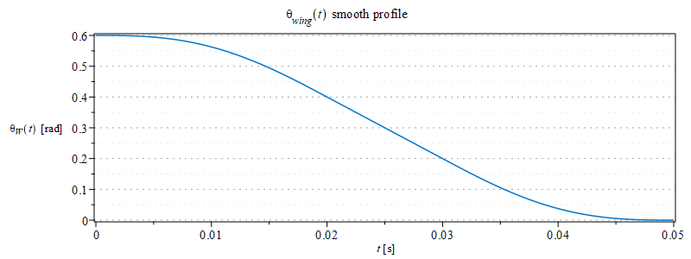
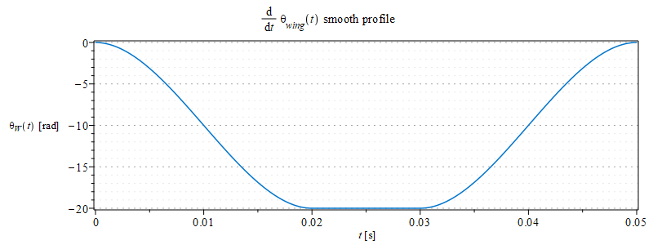
ASSUMPTION PROFILE OF THE ANGLE OF THE FLAP

Slide 9
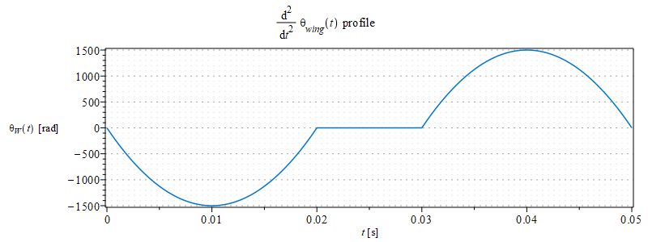
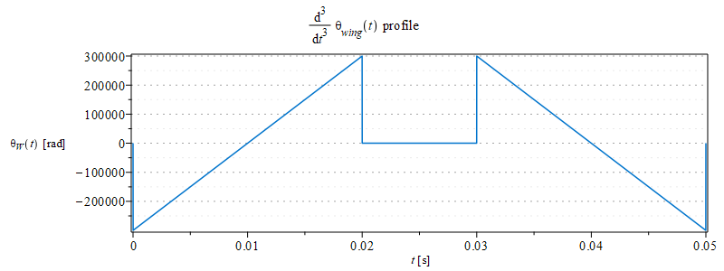
ASSUMPTION PROFILE OF THE ANGLE OF THE FLAP

Slide 10
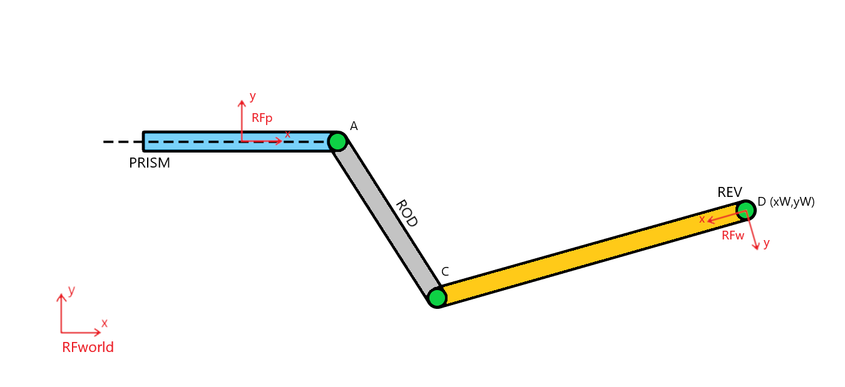
PUSH UP Mechanism Description

Slide 11
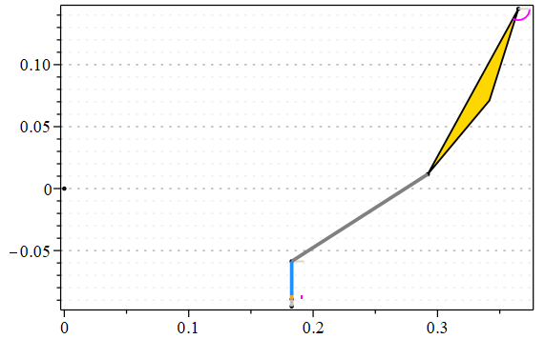
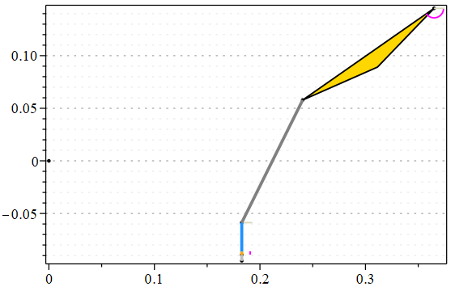
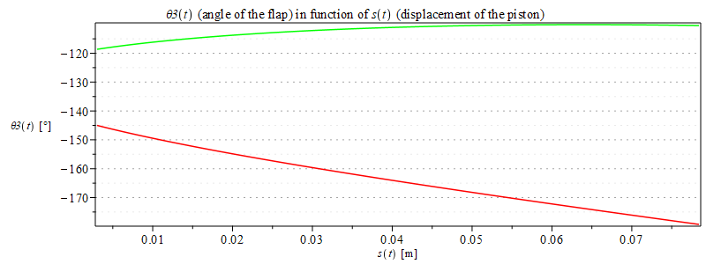
PUSH UP Position analysis
Constraint equation
Range of motion of the piston Initial configuration problem
Position analysis

Slide 12
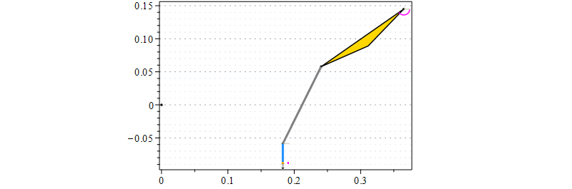
PUSH UP Motion of the mechanism
Angle of the flap: 35°
Piston displacement: 8 cm
Length of the rod: 13 cm

Slide 13
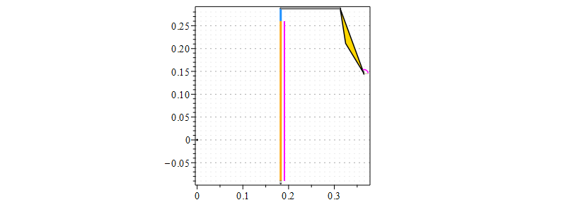
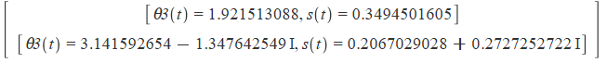
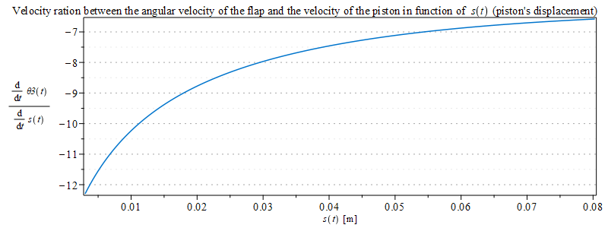
PUSH UP Velocity analysis
Velocity ratio
Singular configurations

Slide 14
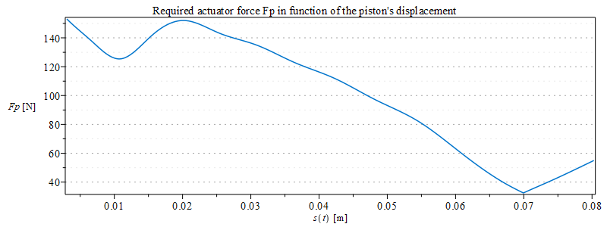
PUSH UP Principle of virtual work
Virtual displacements of the center of mass of the piston and the flap and the rotation of the flap
External forces that acts on the mechanism
Static conditions

Slide 15
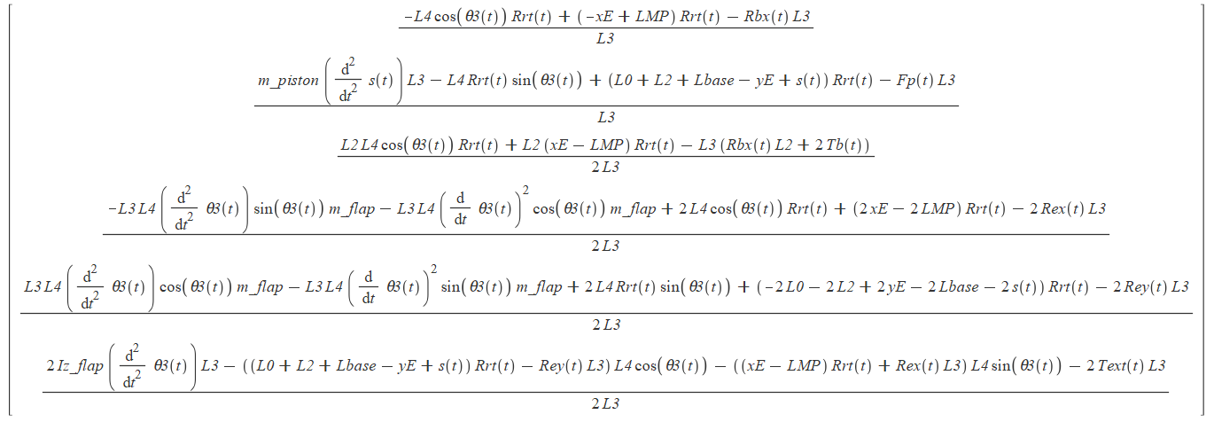
PUSH UP Newton Euler approach
Reaction forces:
Prismatic joint: force and torque (Rbx(t), Tb(t));
Rod joint between the flap and the piston: tension, since it is assumed massless, (Rr(t));
Revolute joint between the flap and the ground (Rex(t), Rey(t));

Slide 16
PUSH UP Lagrange approach
Used in order to have less equations in the dynamic optimization part
It involves directly the constraint equation (associated to the rod joint) using λ1(t)

Slide 17
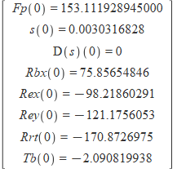
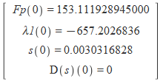
PUSH UP ODE resolution
Imposing a given trajectory to the flap, it’s possible to solve an ODE imposing the initial conditions for the reaction forces (case of Newton – Euler approach) and lambda (case of Lagrange approach), for the initial position and velocity of the piston and for the initial value of the piston force.

Slide 18
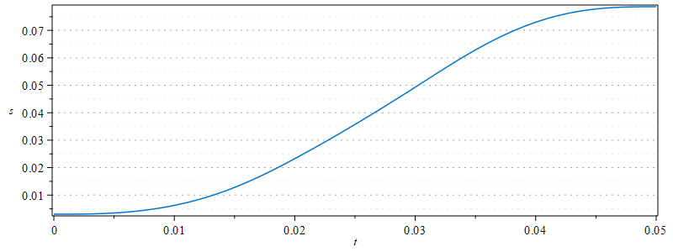
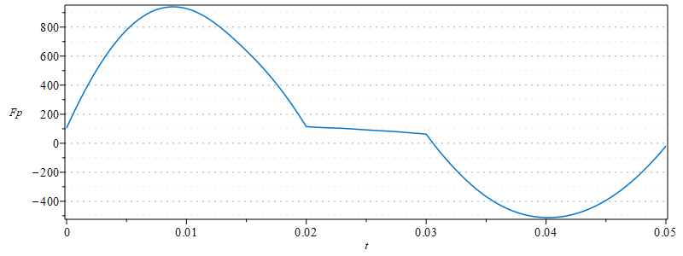
PUSH UP INVERSE DYNAMIC resolution
INVERSE DYNAMIC resolution
Initial conditions
Inverse kinematic analysis in order to obtain the trajectory of the piston
Algebraic problem used to find the reaction forces (or lambda1) and the force of the piston Fp
Piston Force Fp(t)
Maximum value: 940.000005224270N

Slide 19
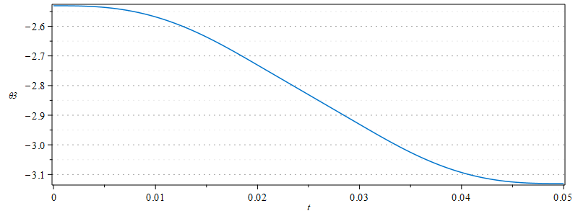
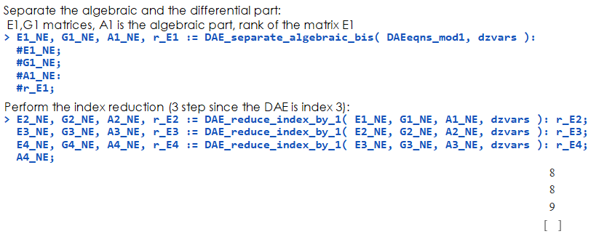
PUSH UP DAE resolution
Dae Resolution
Index reduction step by step using a LUDecomposition
Index reduction using Bertolazzi’s toolbox
Initial conditions for positions and velocities of the flap and the piston and for the reaction forces
DAE resolution using dsolve and imposing a given force to the piston

Slide 20
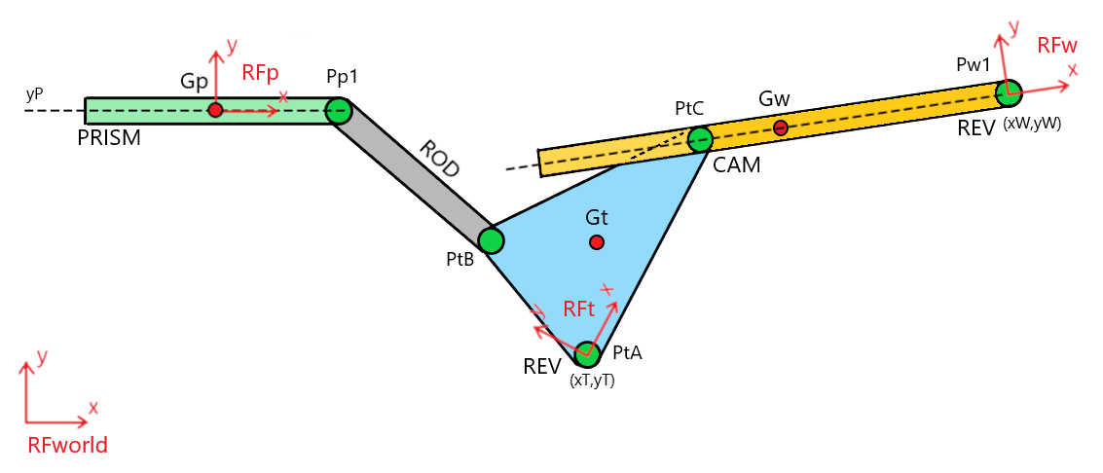
POD ROCKER-KINEMATIC ANALYSIS

Slide 21
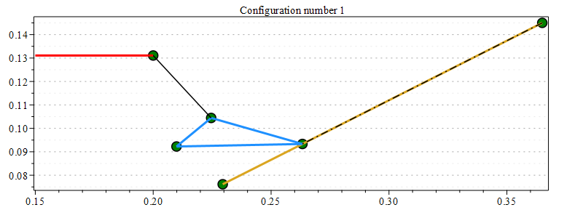
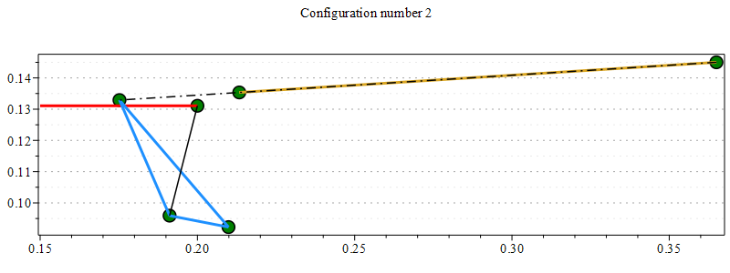
POD ROCKER-KINEMATIC ANALYSIS
POSITION ANALYSIS – DIRECT KINEMATIC (qI = xP)

Slide 22
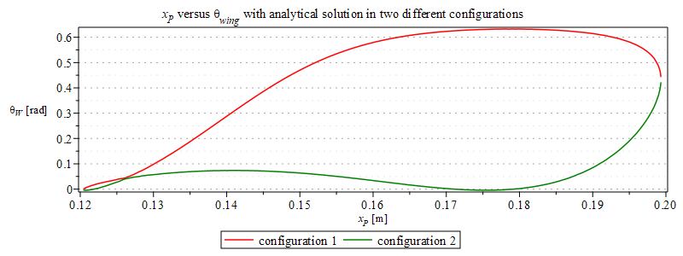
POD ROCKER-KINEMATIC ANALYSIS
POSITION ANALYSIS – DIRECT KINEMATIC (qI = xP)

Slide 23
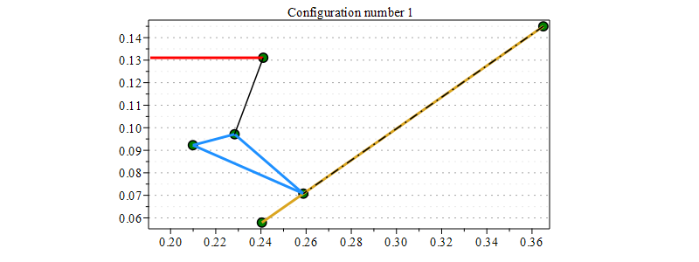
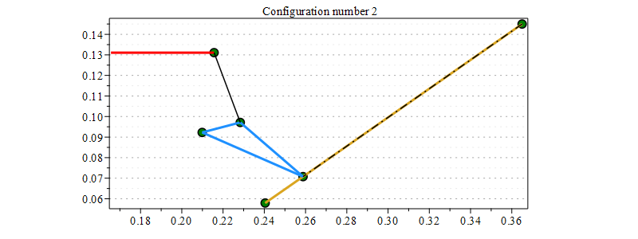
POD ROCKER-KINEMATIC ANALYSIS
POSITION ANALYSIS – DIRECT KINEMATIC (qI = thetaW)

Slide 24
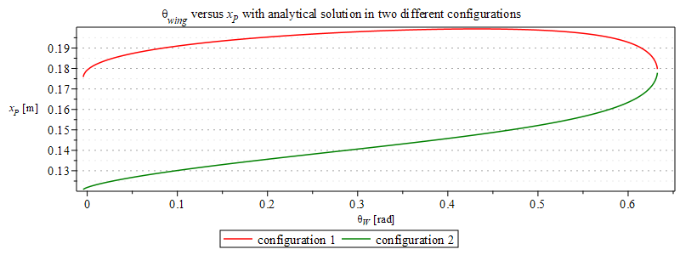
POD ROCKER-KINEMATIC ANALYSIS
POSITION ANALYSIS – DIRECT KINEMATIC (qI = thetaW)

Slide 25
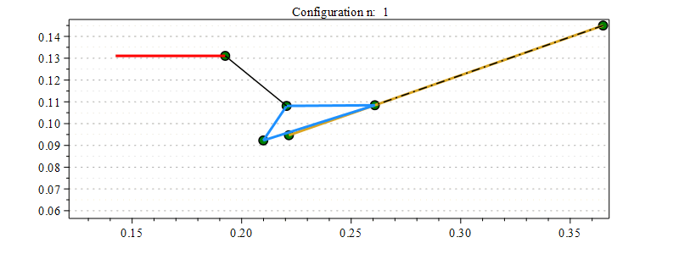
POD ROCKER-KINEMATIC ANALYSIS
POSITION ANALYSIS – DIRECT KINEMATIC (qI = thetaW)

Slide 26
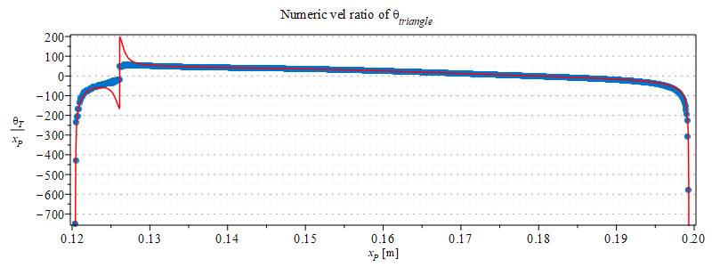
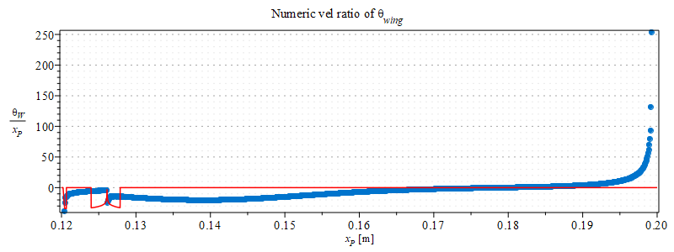
POD ROCKER-KINEMATIC ANALYSIS
VELOCITY ANALYSIS – VELOCITY RATIOS

Slide 27
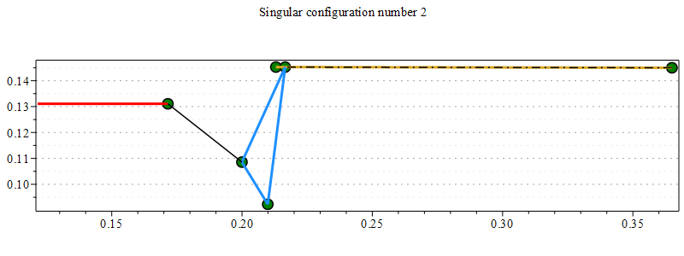
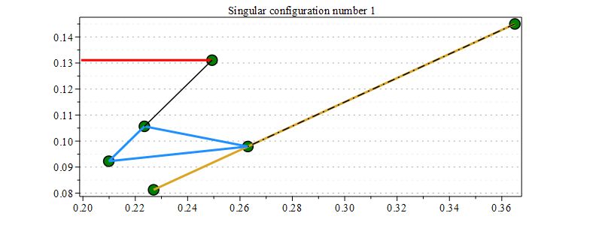
POD ROCKER-KINEMATIC ANALYSIS
VELOCITY ANALYSIS – SINGULAR CONFIGURATIONS
xP(t)=0.1993212061, thetaT(t)=0.1058421609, thetaW(t)=0.4325729110
xP(t) = 0.1204449791,
thetaT(t) = 1.692504172, thetaW(t) = -0.001786259444

Slide 28
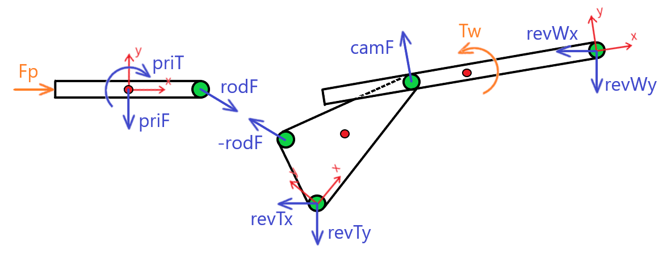
POD ROCKER-DYNAMIC ANALYSIS

Slide 29
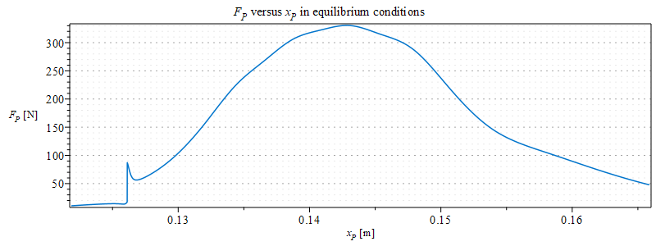
POD ROCKER-DYNAMIC ANALYSIS
PVW – PISTON FORCE IN STATIC CONDITIONS
MaxFp = 330.61642472216977 @ xP = 0.14283656557531654

Slide 30
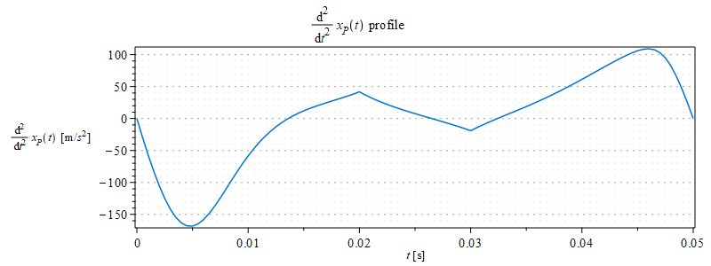
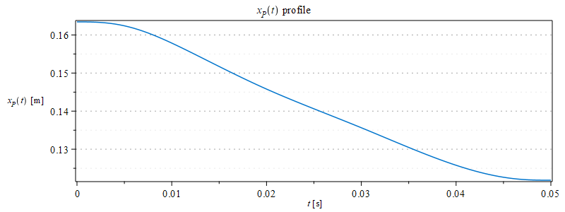
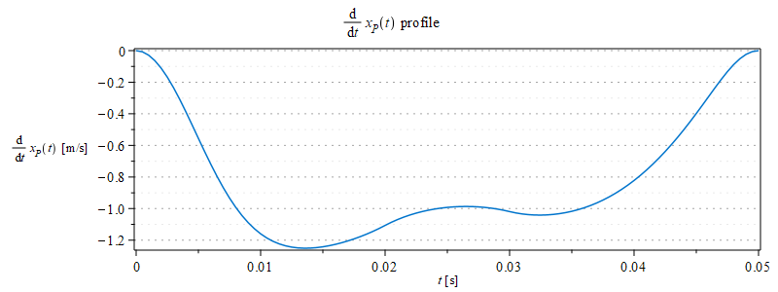
POD ROCKER-DYNAMIC ANALYSIS
NE – INVERSE DYNAMIC

Slide 31
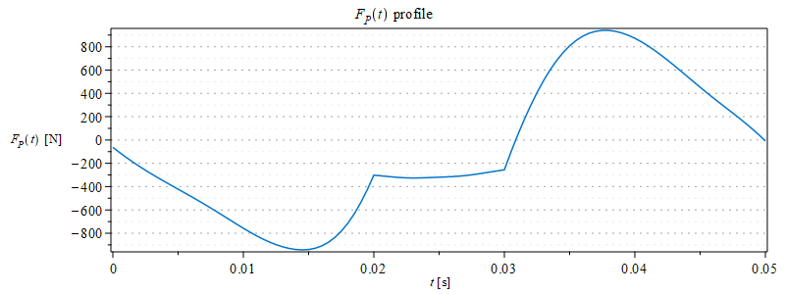
POD ROCKER-DYNAMIC ANALYSIS
NE – INVERSE DYNAMIC
Max piston force: 943.0621997

Slide 32
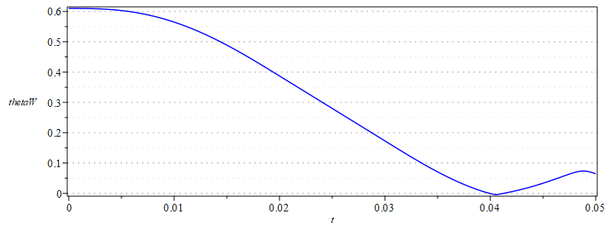
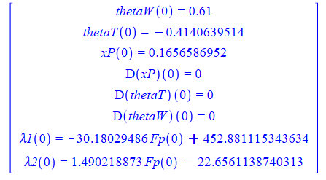
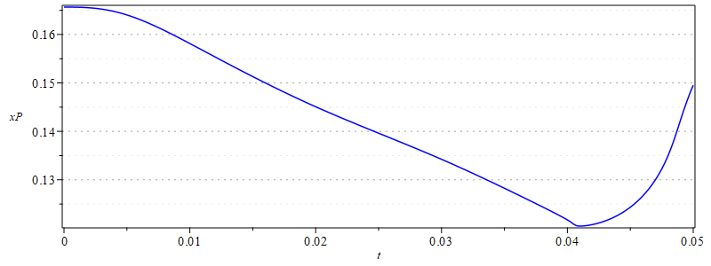
POD ROCKER-DYNAMIC ANALYSIS
LG – DIRECT DYNAMIC
Initial conditions:

Slide 33
POD – PULL MECHANISM
KINEMATIC ANALYSIS

Slide 34
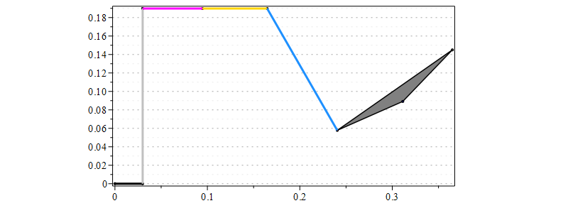
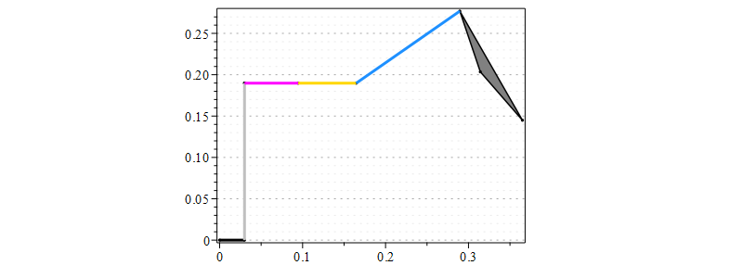
POD – PULL MECHANISM
POSITION ANALYSIS – DIRECT KINEMATIC

Slide 35
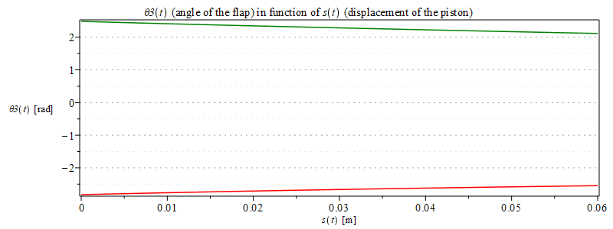
POD – PULL MECHANISM
POSITION ANALYSIS – DIRECT KINEMATIC

Slide 36


POD – PULL MECHANISM
POSITION ANALYSIS – INVERSE KINEMATIC

Slide 37

POD – PULL MECHANISM
ANIMATION

Slide 38

POD – PULL MECHANISM
VELOCITY RATIOS – INVERSE KINEMATIC

Slide 39

POD – PULL MECHANISM
KINEMATIC ANALYSIS

Slide 40

POD – PULL MECHANISM
DYNAMIC ANALYSIS

Slide 41


POD – PULL MECHANISM
DYANAMICS - PRINCIPLE OF VIRTUAL WORK

Slide 42

POD – PULL MECHANISM
DYANAMICS - PRINCIPLE OF VIRTUAL WORK

Slide 43

POD – PULL MECHANISM
NEWTON – EULER APPROACH

Slide 44
POD – PULL MECHANISM
LAGRANGE APPROACH

Slide 45


POD – PULL MECHANISM
ODE RESOLUTION – INITIAL CONDITIONS

Slide 46


POD – PULL MECHANISM
INVERSE DYNAMICS RESOLUTION

Slide 47




POD – PULL MECHANISM
REACTION FORCES

Slide 48


HYDRAULICS

Slide 49


HYDRAULICS PUSH-UP MECHANISM

Slide 50


HYDRAULICS POD-ROCKER MECHANISM
max pressure: 29.92994460

Slide 51


HYDRAULICS POD-PULL MECHANISM

Slide 52
COMPARISON
SPECS | PUSH - UP | POD - ROCKER | POD - PULL
Piston displacement [m] | 0.0802 | 0.0438 | 0.0646
Avg velocity ratio [-] | -7.909 | -13.65 | 6.286
Max force [N] | 940.0 | 943.1 | 1287.9
Max power [W] | 1120 | 1176 | 1224
# of bodies | 2 | 3 | 2
# of joints | 3 | 5 | 3
Max tot reaction force [N] | 3366.98 | 5883.80 | 3475.61
Extra weight [kg] | - | + 0.0119 | -

